Slide 1

Predicting Used Car Prices
-A Machine Learning Approach
-By Nidhi Patel

Slide 2
Description
Develop a robust machine learning model to accurately predict used car prices in the market.
By utilizing this model, the company aims to improve pricing recommendations, optimize inventory management, and help both buyers and sellers make informed decisions.
🧠 Business Context
The used car market is rapidly growing with increased demand for reliable price evaluation.
Accurate price prediction helps customers make informed decisions and empowers dealers to set competitive prices.

Slide 3
Objective
Analyze the key factors affecting used car prices.
Perform data cleaning and exploratory analysis.
Build regression models to predict car prices.
Evaluate model performance and interpret key insights.

Slide 4
Workflow
Data Collection
Data Cleaning & preprocessing
Exploratory Data Analysis
Feature Engineering
Model Development
Model Evaluation
Insights & Results

Slide 5
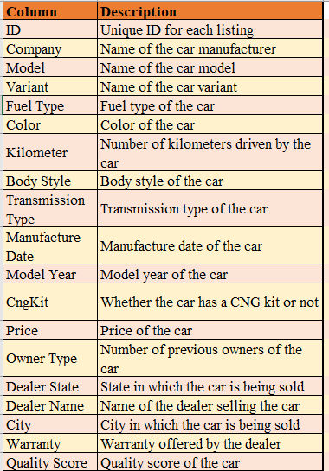
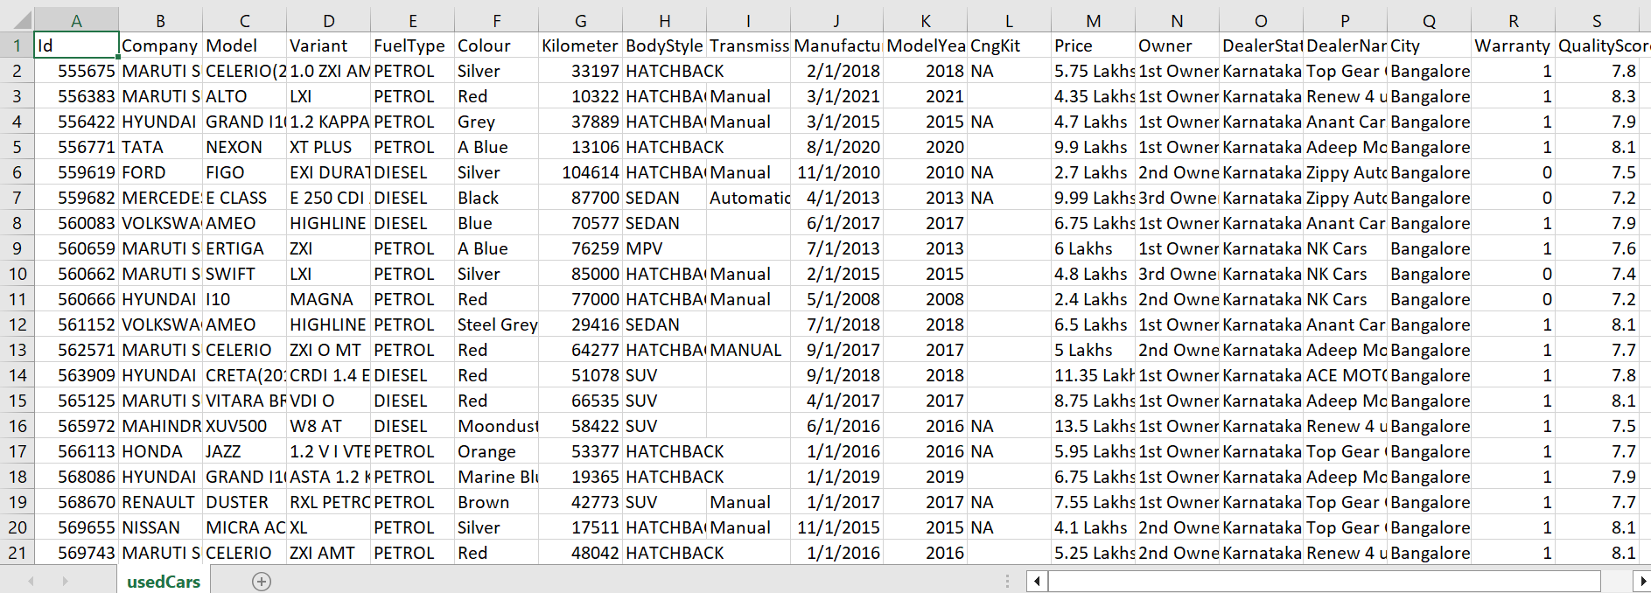
Data Description
Most of the columns (14 out of 19) are of Object data type.
Only the QualityScore column is of the float64 data type.
Rest columns Id, Kilometer, ModelYear and Warranty are of int64 data type.

Slide 6
Methodology
🔧 Preprocessing:
- Removed unnecessary columns such as Id and DealerName.
- Derived column “CarAge” from ModelYear.
- Missing Value Treatment:
  There appear to be three columns which has missing values in the dataset TransmissionType with 714, CngKit with 1042 and FuelType with 1 missing entries.
  Missing values in TransmissionType column was handled based on Mode value and CngKit were handled with placeholder “No”. And FuelType with “Petrol”.

Slide 7
Methodology
🔧 Preprocessing:
- Data Type Treatment:
  Removed ‘ Lakhs’ from column Price to convert into float64 entries and text from column Owner to convert into int64.
  Converted 'ManufactureDate' to datetime.
- Categorical Data Treatment:
  Using Label Encoder, performed encoding on all the columns whose datatype was Object.

Slide 8
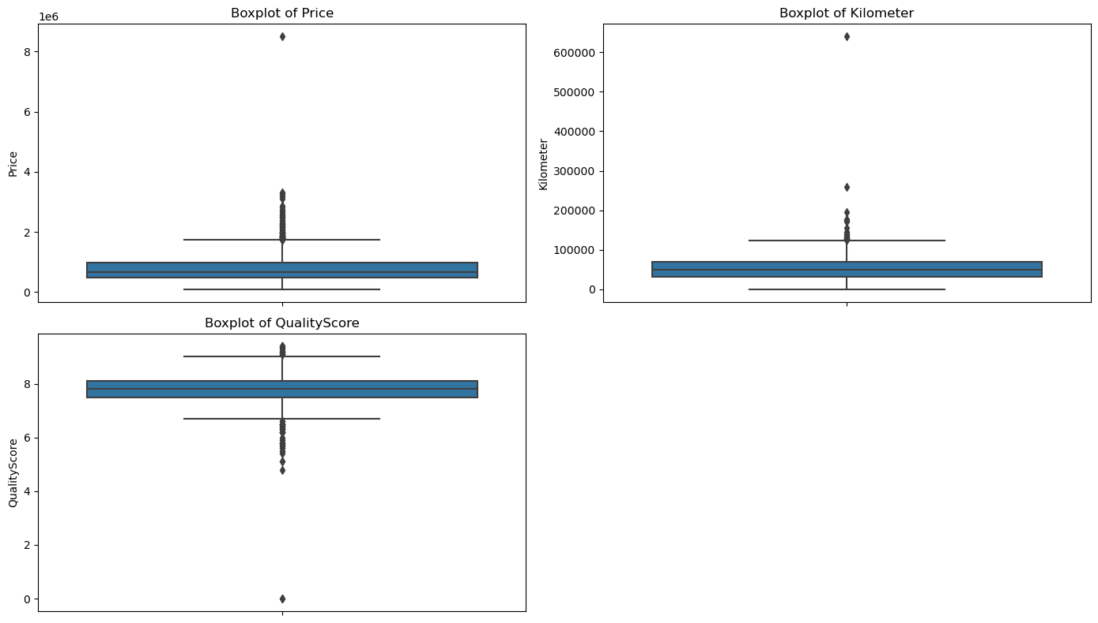
Methodology
🔧 Preprocessing:
- Outlier Treatment:
  Using box plots, detected outliers on columns such as Price, Kilometer and QualityScore.

Slide 9
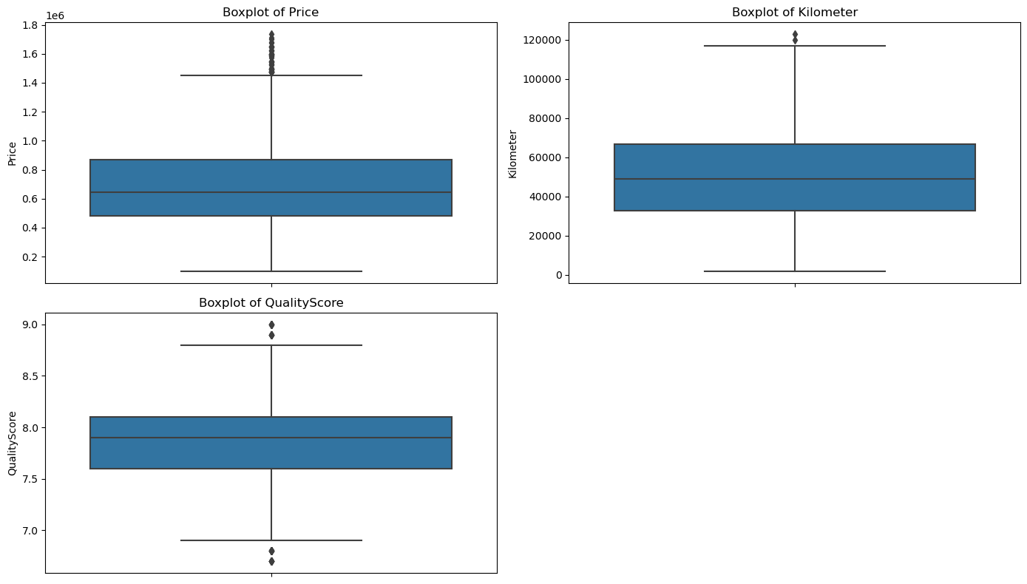
Methodology
🔧 Preprocessing:
- Outlier Treatment:
  Removed outliers using IQR and domain knowledge.

Slide 10
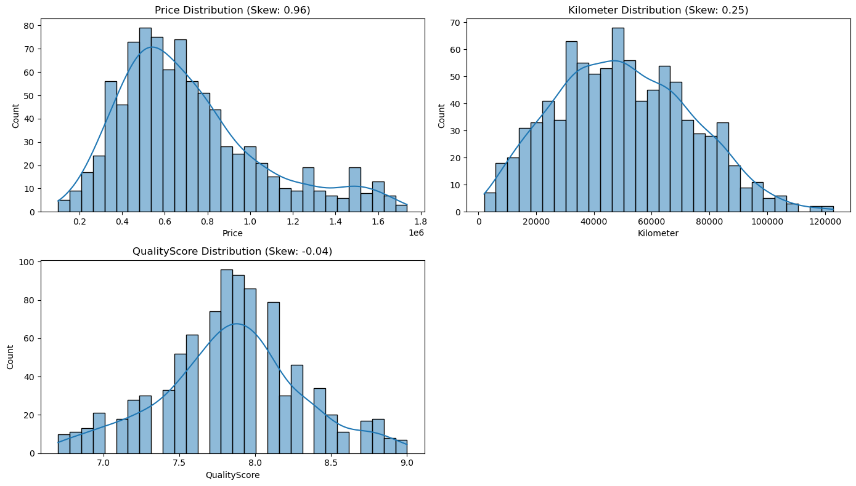
Exploratory Data Analysis (EDA)
After removing outliers, Distribution of data for Price feature is spread across its range. (0.1 , 1.7). Where most of the data points lies in range (0.4, 0.8).
Kilometer column’s data range is 0.1 to 120000.
The data distribution for QualityScore is lying between 0.3 to 9.0

Slide 11
Exploratory Data Analysis (EDA)
📊 EDA:
- Analyzed car price trends across brands, fuel types, transmission types, and ownership count.
- Observed negative correlation between price and car age.
- Identified that certain brands and transmission types demand premium prices.

Slide 12
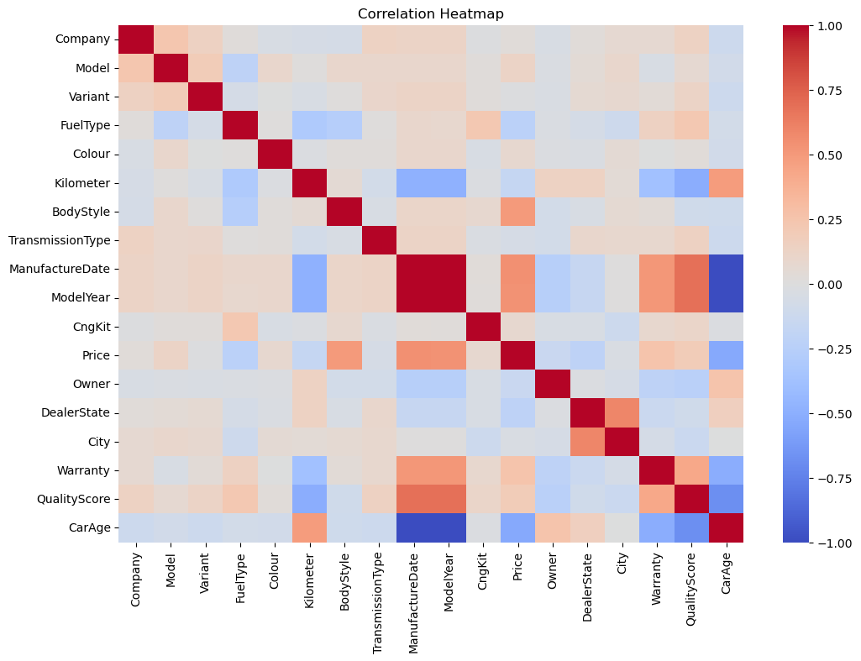
Exploratory Data Analysis (EDA)
Correlation of features:

Slide 13
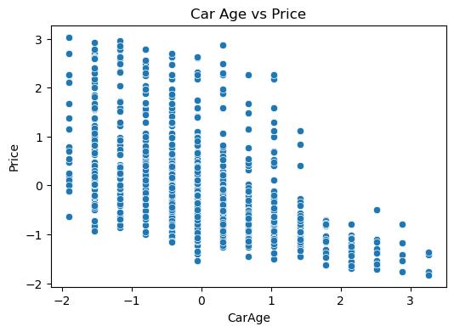
Exploratory Data Analysis (EDA)
Scatterplot for
Car Age vs Price:

Slide 14
Model Implementation
🤖 Model Development:
- Train-Test Split: 80:20 ratio
- Models Implemented:
  Linear Regression
  Decision Tree
  Random Forest Regressor
- Applied GridSearchCV and cross-validation for hyperparameter tuning.

Slide 15
Model Results
📉 Model Evaluation
Metrics used for evaluation:
  R² Score: Measures goodness of fit
  Root Mean Squared Error (RMSE)
  Mean Absolute Error (MAE)

Slide 16
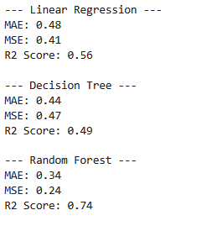
Model Results
✅ Best Model: Random Forest
- MAE (0.34) : Lowest — predictions are closer to the actual values.
- MSE (0.24) : Lowest — fewer large errors
- R² Score (0.74): Best — explains 74% of the variance, which is decent for real-world used car pricing.
So yes, Random Forest is currently the most accurate and robust model among the three.

Slide 17
Model Results
🏁 Results & Key Insights
Car Age is the most influential factor in predicting resale value
Company reputation plays a strong role — cars from Maruti, Toyota, and Honda retain value better
Automatic cars are generally priced higher than manual ones
Fuel type impacts price significantly — Diesel cars command higher resale for certain brands
Final model can predict prices within a margin of ₹50,000 for most cases

Slide 18
Conclusion
🧾This project demonstrates the effectiveness of machine learning in the domain of price prediction for used cars. The developed model offers practical utility in the automotive resale ecosystem by promoting pricing fairness and data transparency. With further integration and data enrichment, this solution can evolve into a comprehensive pricing intelligence tool for dealerships, car aggregators, and customers.

